Slide 1
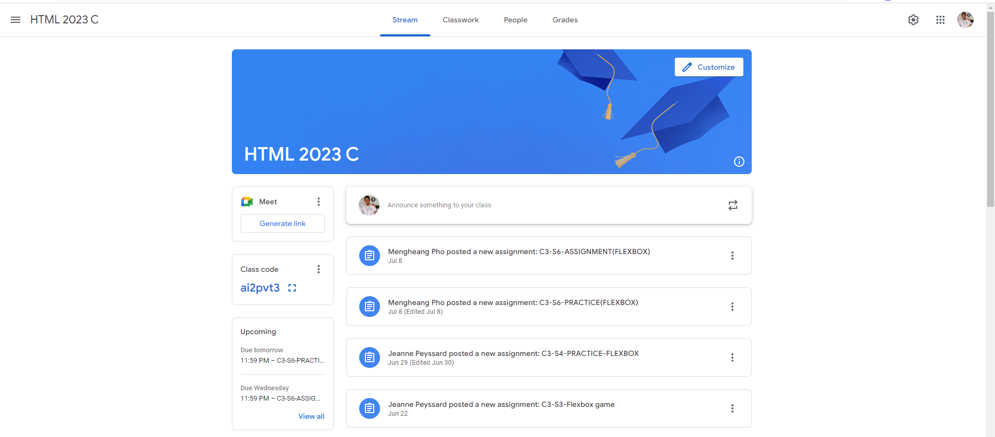
Identify root components of website below

Slide 2
Flex:0 Nav
Flex:1 main

Slide 3
Nav
Nav-left
Nav-center
Nav-right
Flex-direction: row
Justify-content: space-between

Slide 4
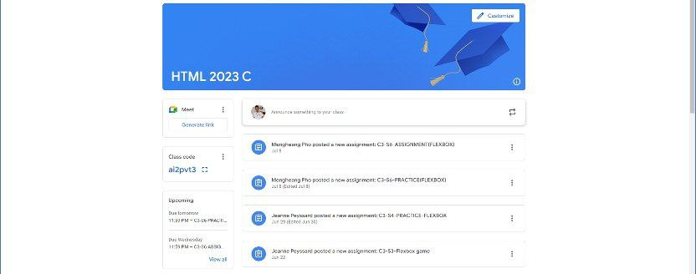
main
Flex:0 Class-title
Flex:1 Class-info
Flex-direction: column;

Slide 5
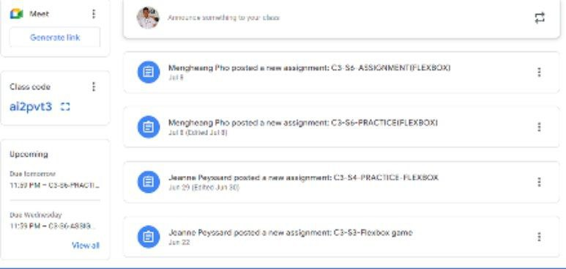
Class-info
Flex: 0
Class-meet
Flex: 1
Class-stream
Flex-direction: row;

Slide 6
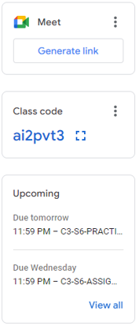
Meet-link
Flex: 0
Meet-code
Flex: 0
Flex-direction: column;
Meet-upcoming
Flex: 1

Slide 7
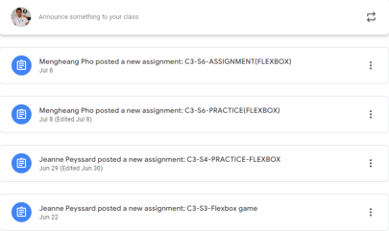
Toolbar flex: 0
Class-post
Flex: 1
Flex-direction: column;

Slide 8

img
Insert-bar
Flex:0
Flex: 1
Flex-direction: row;

Slide 9

img
Post-content
Flex:0
Flex: 1
Flex-direction: row;

